Slide 1

Stroke prediction

Slide 2

Agenda
Problem Definition
Data Description
EDA
Machine Learning Approach
Result

Slide 3
Stroke
The blood supply to the brain is blocked or reduced
Brain cell destruction
Paralysis, blindness, speech slurring, etc
Some facts
About 800,000 people suffered stroke
About 160,000 people die
Percentage Increase 15%

Slide 4
Data description
Gathered from Kaggle
Published on January 26, 2021
By Soriano, F
5110 Observations
11 features

Slide 5
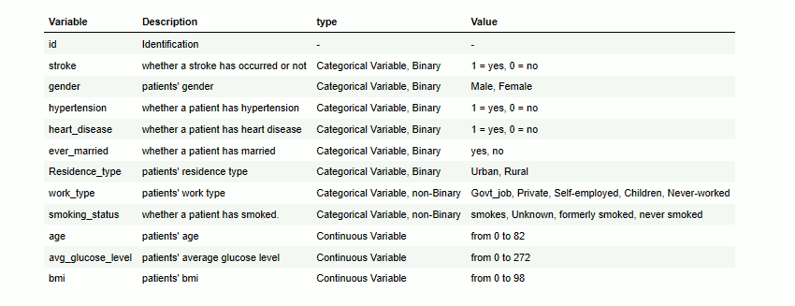
Data description
Identifier
8 Categorical Variables
6 Binary Categorical Variables
2 non-binary Categorical Variables
3 Continuous Variables

Slide 6
DatA cleaning
Issues & Cleaning
202 null data
Dropped 202 null data points
Non relevant column
Dropped ID column
Inconsistency
Labeling Categorical variables into int value

Slide 7
EDA
Finding & Decision
Outlier
Meaningful Data, Not drop
Correlation & Collinearity
Age – BMI correlated but No Collinearity
Data Imbalance
Conduct SMOTE

Slide 8
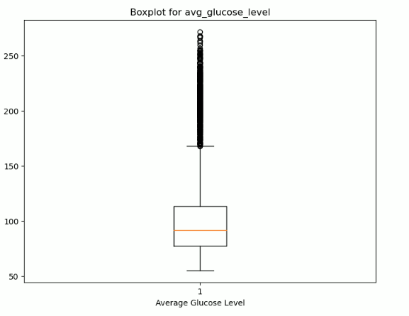
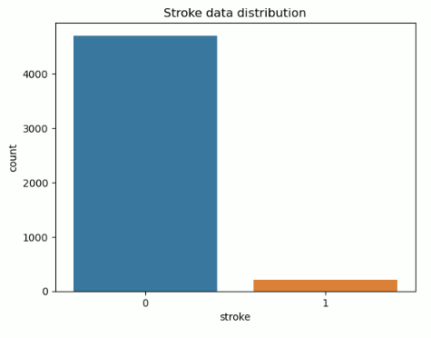
Visualization

Slide 9
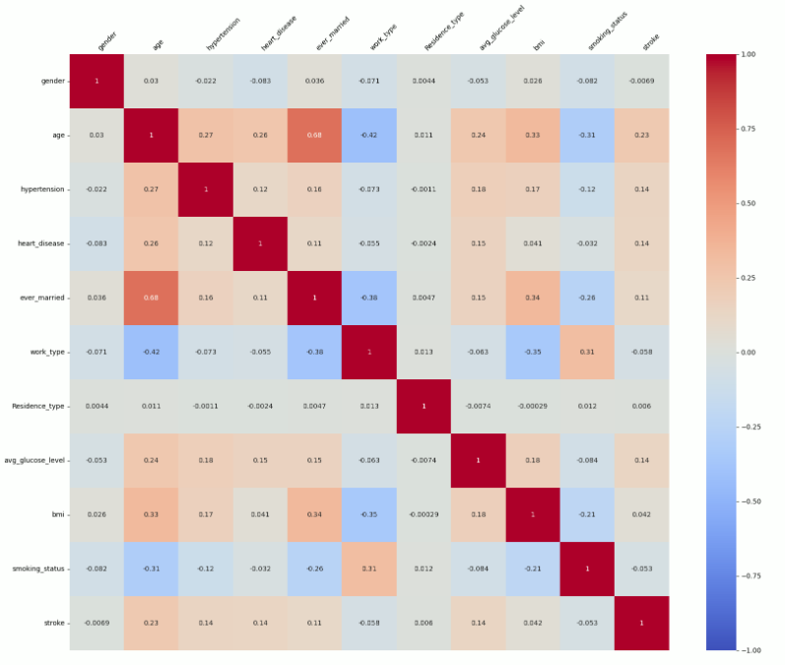
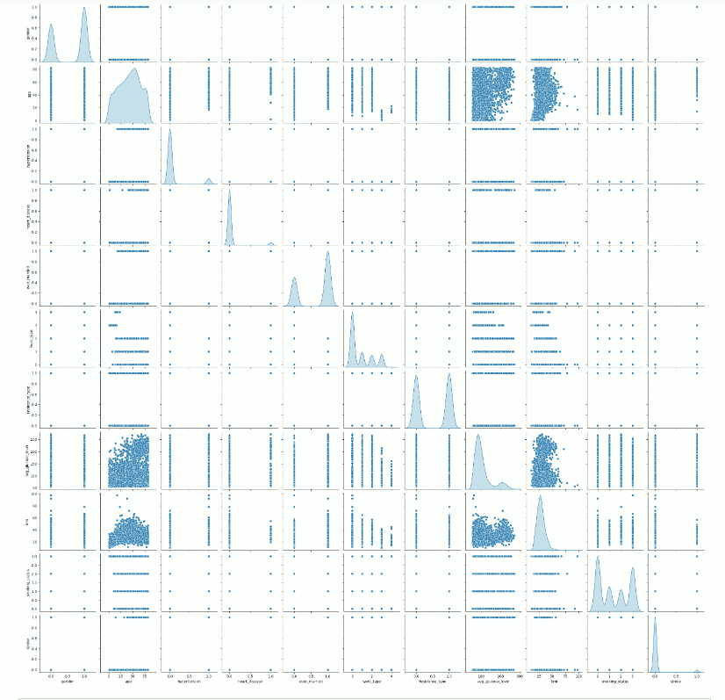
visualization

Slide 10
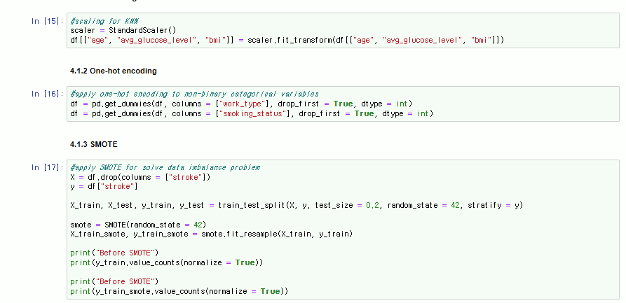
Model
Preparation
Scaling
One-hot Encoding
SMOTE

Slide 11
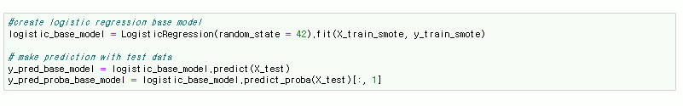
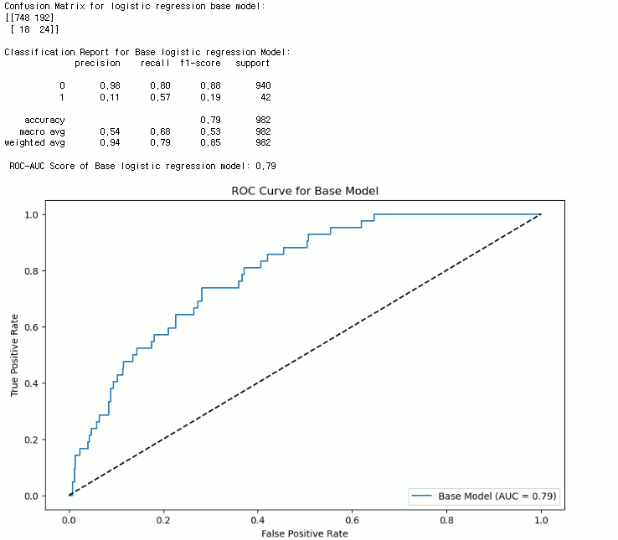
Model – Logistic regression
Base Model
Precision: 0.11
Recall: 0.57
F1-score: 0.19
ROC-AUC: 0.79

Slide 12
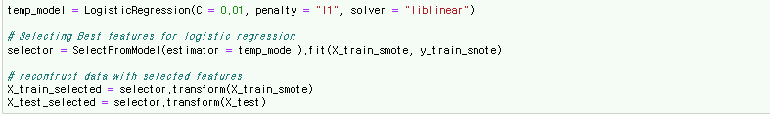

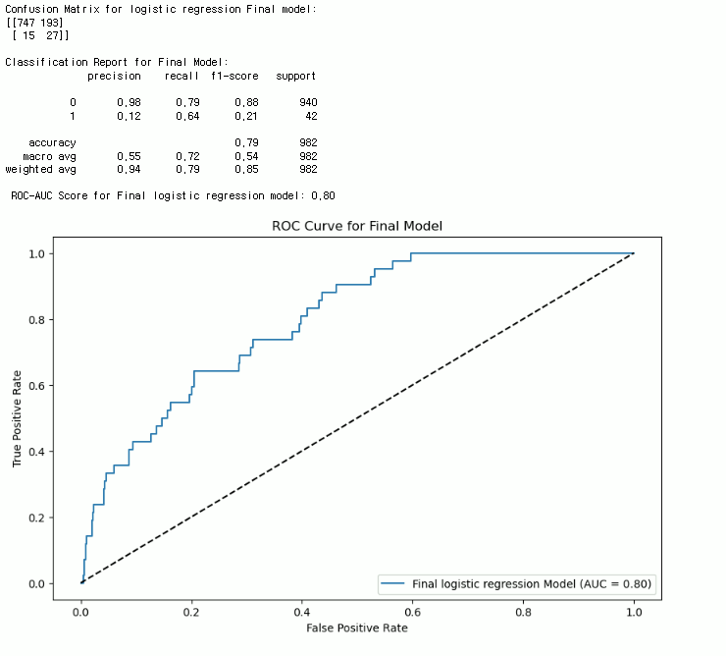
Model – Logistic regression
Final Model
Precision: 0.12
Recall: 0.64
F1-Score: 0.21
ROC-AUC: 0.80

Slide 13

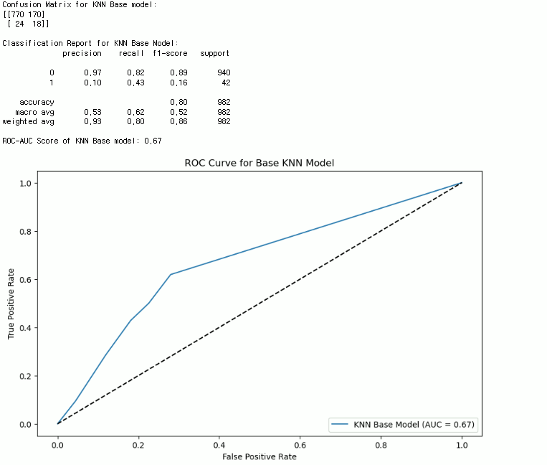
Model – KNN
Base Model
Precision: 0.10
Recall: 0.43
F1-score: 0.16
ROC-AUC: 0.67

Slide 14
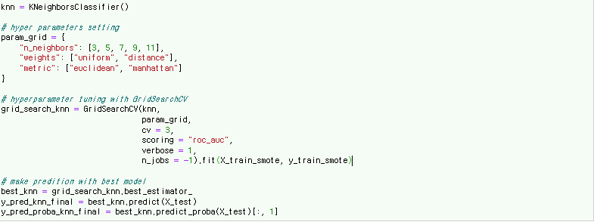
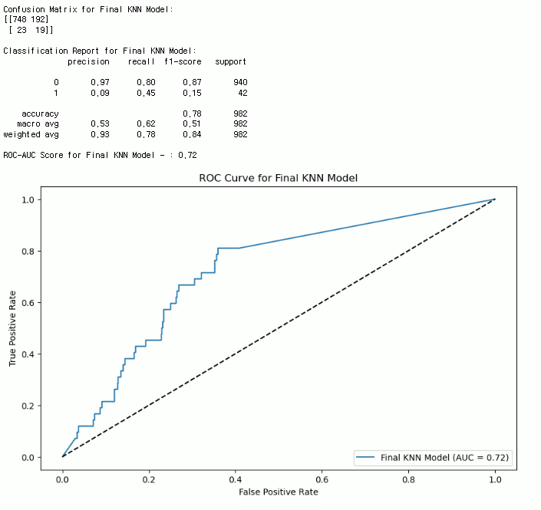
Model – KNN
Final Model
Precision: 0.09
Recall: 0.45
F1-score: 0.15
ROC-AUC: 0.72

Slide 15
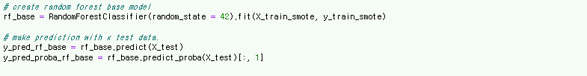
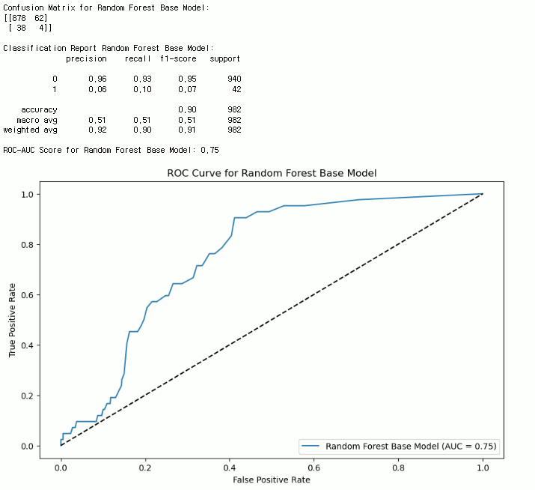
Model – Random Forest
Base Model
Precision: 0.06
Recall: 0.10
F1-score: 0.07
ROC-AUC: 0.75

Slide 16
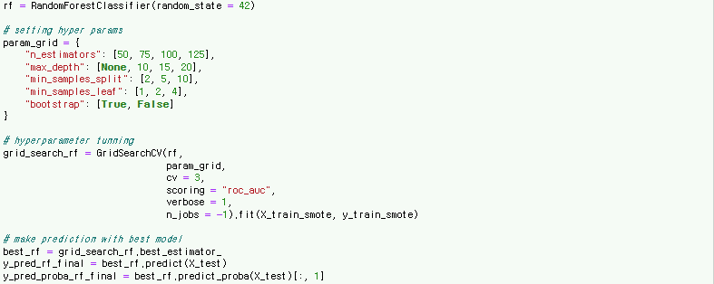
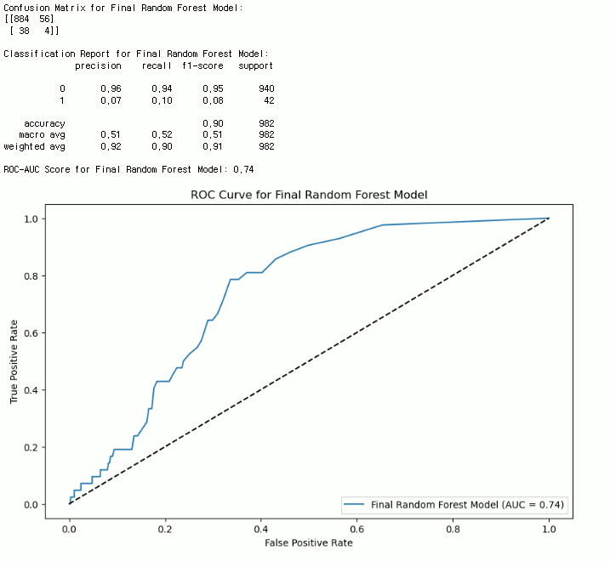
Model – Random Forest
Final Model
Precision: 0.07
Recall: 0.10
F1-score: 0.08
ROC-AUC: 0.74

Slide 17
Model - comparison
Model | Precision | Recall | F1-Score | ROC-AUC
Logistic Regression | 0.12 | 0.64 | 0.21 | 0.8
KNN | 0.09 | 0.45 | 0.15 | 0.72
Random Forest | 0.07 | 0.1 | 0.08 | 0.74

Slide 18
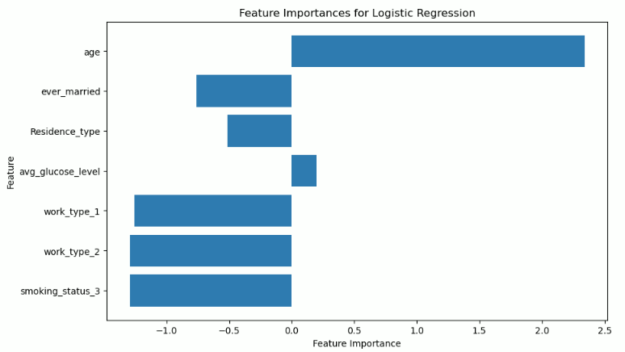
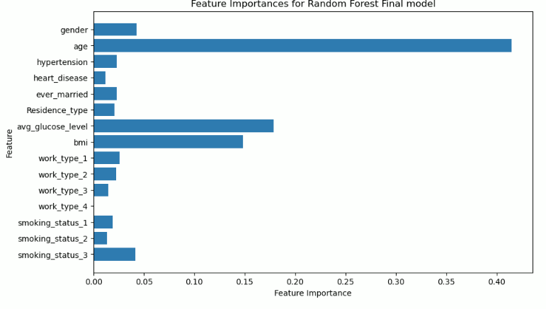
Model – Feature importance

Slide 19
Result
Random Forest
Important Feature
AGE, BMI, AVG_GLUCOSE_LVL
Final Selected Model
Logistic Regression

Slide 20
Thank you
Github: https://github.com/yongki0704/Stroke_prediction

